Slide 1
EUMETSAT Status Report
GODEX_{NWP}
New Delhi, India
27-30 November 2018

Slide 2

Darmstadt - EUMETSAT

Slide 3
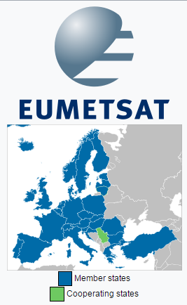




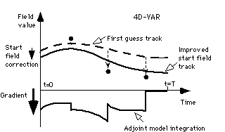
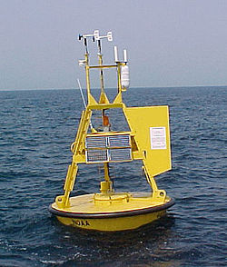
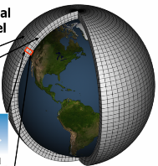
➔ EUMETSAT

Slide 4




EUMETSAT is a European Organisation
Member States
AUSTRIA
BELGIUM
BULGARIA
CROATIA
CZECH REPUBLIC
DENMARK
ESTONIA
FINLAND
FRANCE
GERMANY
GREECE
HUNGARY
ICELAND
IRELAND
ITALY
LATVIA
LITHUANIA
LUXEMBOURG
THE NETHERLANDS
NORWAY
POLAND
PORTUGAL
ROMANIA
SLOVAK REPUBLIC
SLOVENIA
SPAIN
SWEDEN
SWITZERLAND
TURKEY
UNITED KINGDOM

Slide 5
Geostationary Missions
Meteosat-8, launched 28 August 2002, is providing the IODC service since 1/02/2017 at a position of 41.5°E. Planned disposal mid 2020.
Meteosat-9, launched 21 December 2005, has been on station at 9.5°E since 5 February 2013 and supports the Rapid Scanning Service (RSS) since 9 April 2013

Slide 6
Geostationary Missions
Meteosat-10, launched on 5 July 2012, following January 2013 relocations, has been the prime Meteosat satellite for the 0° service since 21 January 2013
The spacecraft is currently in imaging mode, fully configured including GERB-3, DCP and Search and Rescue transponders

Slide 7
Geostationary Missions
Meteosat-11 was launched on 15 July 2015
After the LEOP phase by ESOC, EUMETSAT took over the responsibility for the operations of MSG-4 in orbit on 26 July
Several commissioning tests were executed with the satellite drifting and finally on 2 August 2015 the spacecraft was successfully stopped at the planned commissioning position of 3.4°W

Slide 8

In-orbit Geostationary Spacecrafts
Met-9
Met-11
Met-10
Met-8
3.4°W
0°
9.5°E
41.5°E
In-Orbit Storage
Prime Mission
Rapid Scan Service
IODC

Slide 9
Low Earth Orbit Missions – EUMETSAT Polar System
The EUMETSAT Polar System has continued to perform well and to meet its operational service specification. Metop-B and Metop-A are providing a dual-Metop operational service, with Metop-B designated as the prime Metop satellite. Metop-B half-dumps are routinely acquired over McMurdo, giving the improved data timeliness of the Antarctic Data Acquisition Service for those orbits. Metop-C was launched successfully on 7thNovember 2018.

Slide 10
Status of Metop Spacecrafts
Metop-A S/C Launched 19 October 2006 | LRPT: Red | AMSU-A1: Channel 7 failed, Channel 3 NEDT is out of spec. Channel 8 NEDT is out of spec. | MHS: H3 and H4 degrading but NEDT still within spec. | AHRPT: Operated only over “secure” zones
Metop-B S/C Launched 17 September 2012 | HIRS: Channels 5, 6 and 10 currently out of spec. Others in specification. | AMSU-A1: Channel 15NEDT is out of spec ADCS: Degradation of received messages between 30 and 50% because of CRA antenna cable swap. as per request, run mission as ARGOS-2. ADCS transmitter is off, ADCS receiver is on. |  | SARR and SARP: Degradation of received messages in nominal beacon conditions between 0 and 10%, in worst beacon and environmental conditions up to 100%, because of CRA antenna cable swap

Slide 11
NOAA Initial Joint Polar System Satellites
  NOAA-19, launched 6 February 2009, continues to be operated with the support of EUMETSAT as prime for ADCS and SARSAT mission services and with all other instrument data also being processed, within the IJPS framework. NOAA-19 HIRS IR Channels remain noisy
  Suomi-NPP, launched on 28 October 2011, is the first of the new generation polar orbiting satellites from NOAA in the afternoon orbit. Suomi-NPP has been the nominal IJPS satellite on the afternoon orbit since 1 May 2014.
  NOAA-20 (ex JPSS-1) was launched in November 2017. Global ATMS and CrIS SDRs are redistributed by EUMETSAT via EUMETCast and GTS (as for S-NPP)

Slide 12
Jason-2&3 - Ocean Surface Topography Mission
Jason-2, launched 20 June 2008, provides Operational Geophysical Data Record (OGDR) - which main geophysical parameters are significant wave height and ocean surface wind speed derived from the Poseidon altimeter on board the Jason2 satellite
Jason-3, became the reference altimetry mission on 1 October 2016 after the completion of the tandem flight phase with Jason-2 for cross-calibration purposes.

Slide 13
Sentinel-3
Following the launch of the Sentinel-3A satellite on 16 February 2016 and the conclusion of in-orbit commissioning on 12 July, the formal handover of satellite operations from ESA took place on 13 July 2016.
Routine Operations Readiness Review was in July 2017. All L1 and L2 products operational.
Sentinel-3B was launched in April 2018.

Slide 14
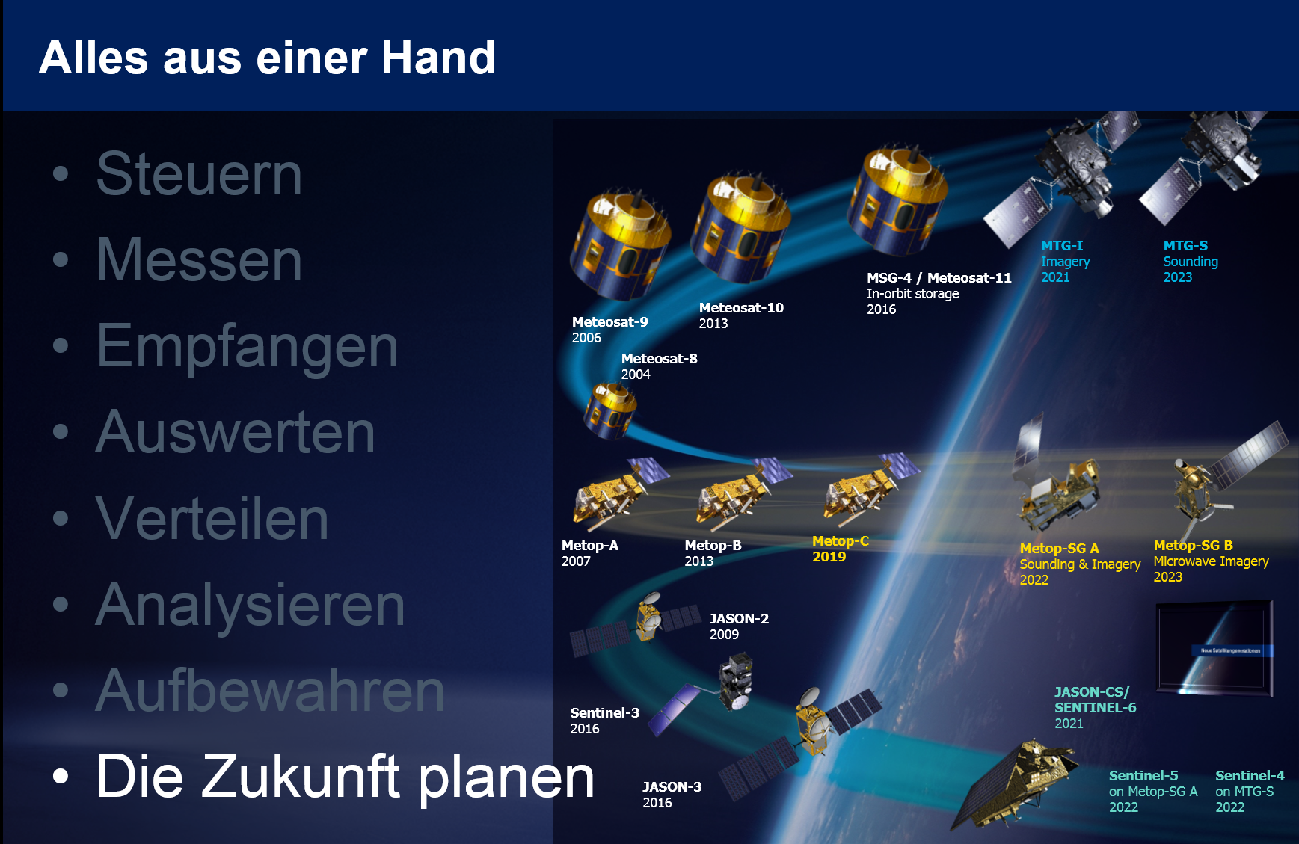
New satellite generations

Slide 15
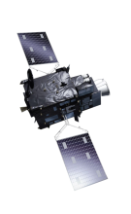
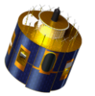
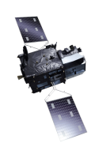
Meteosat Third Generation
Flexible combined Imager (10 / 2.5 minutes)
Lightning Imager (Storm warning)
Infrared Sounder (Temperature- and humidity profile)
UV-VIS-NIR Sounder (Trace gasses, air quaility)

Slide 16
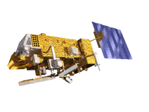


EPS Second Generation
Optical imaging, IR & MW sounding, aerosol imaging, radio occultation, Sentinel-5
MW & sub-mm-wave sounding, scatterometry, radio occultation

Slide 17
Third-party data services

Slide 18
Third-Party Data Services & Data Distribution
NRT data come from various organisations (CMA, CNES, ESA, ISRO, JAXA, JMA, NASA, NOAA, NSOAS, ROSHYDROMET)
The selection and priority setting of data which EUMETSAT tries to make available is done by the STG-OPSWG.
Data reception is done by the satellite provider or on behalf of the satellite provider.
Data policy and data ownership remains with the provider.
Raw data processing is in most cases done by the satellite providers.
Data are transferred to EUMETSAT in various ways (dedicated lines, RMDCN, Internet, ...) using various protocols.

Slide 19
Third-Party Data Services & Data Distribution
Depending on user demands EUMETSAT can reformat or tailor the data.
Data dissemination is done via EUMETCast, in some cases also via GTS.
Archiving is usually not done by EUMETSAT but by the data provider. It can be done on request.
The registration for the reception of 3rd party data follows the same principles as for other EUMETSAT data through the Product Navigator.
Availability and timeliness of data is mostly determined by the data provider.

Slide 20
GEO Third-Party Data Services
Satellite | SSP | Instrument | Format
GOES-15 | 135 W (past) | IMAGER | netCDF
GOES-16 | 75.2 W | ABI, GLM, EXIS | netCDF
GOES-17 | 137 W (final) | ABI | netCDF
Electro-L N2 | 76 E | MSU-GS | HRIT
INSAT-3D | 82 E | IMAGER | HDF
Himawari-8 | 140.7 E | AHI | HRIT
FY-2E | 86.5 E | S-VISSR | HDF
FY-2G | 99.5 E | IMAGER | HDF

Slide 21
LEO Third-Party Data Services
Satellite | Instrument | Data | Format
FY-3B, C | Sounders | L1 | HDF and BUFR
Terra and Aqua | MODIS | L1, L2 and L3 | HDF-4
DMSP F16, -18 | SSMI/S | L1 | BUFR
SMOS | MIRAS | L1 light | BUFR
SARAL | ALtiKa | OGDRs | netCDF-3 and BUFR
SNPP | ATMS, CrIS, VIIRS | SDRs (ATMS and CrIS) and EDRs (VIIRS) | BUFR and netCDF

Slide 22
LEO Third-Party Data Services
Satellite | Instrument | Data | Format
NOAA-15, 18 | Sounders | L1 | BUFR
Megha-Tropique | SAPHIR | L1A2 | BUFR and HDF
GCOM-W1 | AMSR-2 | L1B(R) and SST | BUFR and GHRSST
FY-3B, C | Microwave Imager | L1 | BUFR and HDF
HY-2A | Altimeter, Scatterometer | L2, IGDR, L2B | BUFR, netCDF
GPM-Core | GMI | L1 | BUFR

Slide 23
LEO Third-Party Data Services
Satellite | Instrument | Data | Format
ScatSat | SCAT | L2a/L1b | netCDF
NOAA-20 | ATMS, CrIS | SDRs | BUFR
TANSAT | ACGS (and CAPI) | L1 | netCDF
SMAP | SMAP | L1 | BUFR
SNPP and AURA | OMPS and OMI | L2 | HDF
S-NPP, NOAA-20 and Metops (DBRTN) | ATMS, CrIS and IASI | L1 | BUFR

Slide 24
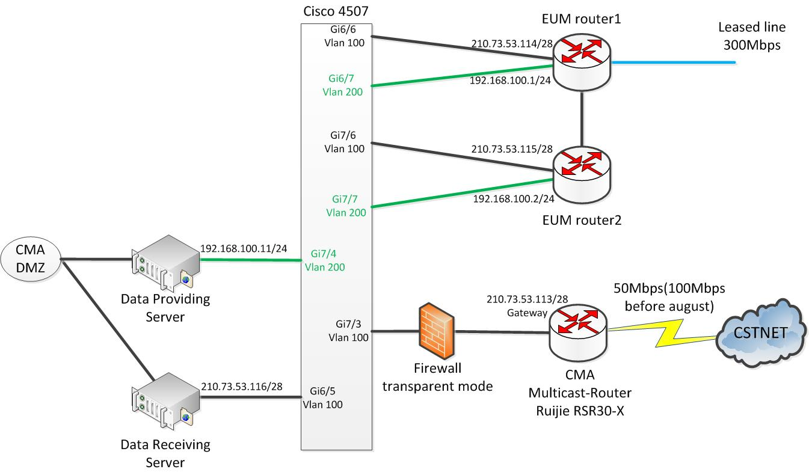
High volume data exchange with CMA
ECT in
P2P WAN out
Temporary route out (via ECT)

Slide 25
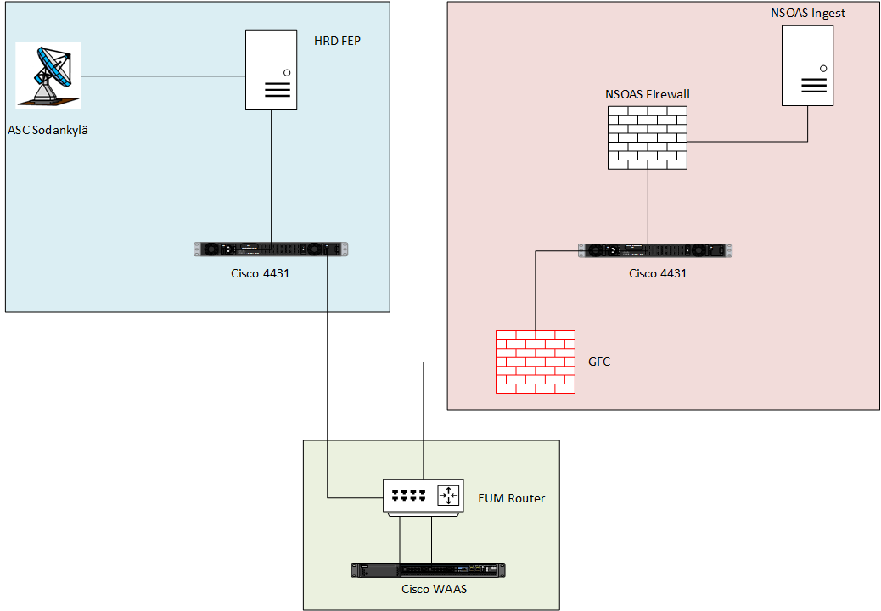
Simple view of network for HY-2A pilot with NSOAS

Slide 26
Regional Service Status

Slide 27
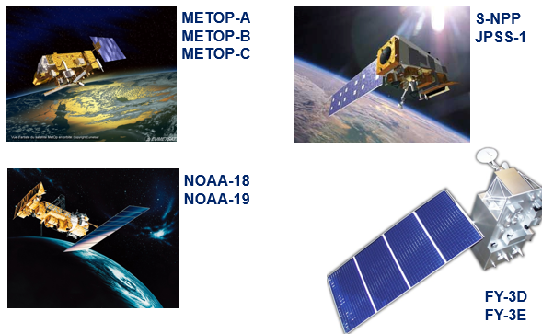
Satellites supported by EARS
FY-3C
Q1 2019

Slide 28
Instruments/Services EARS
EARS-ATOVS
EARS-ATMS
EARS-VASS
EARS-IASI
EARS-CrIS
EARS-AVHRR
EARS-VIIRS
EARS-ASCAT

Slide 29
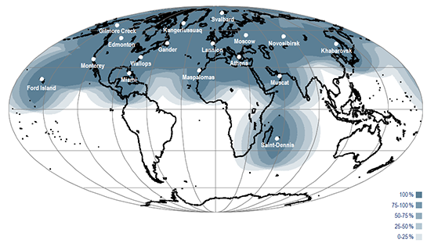
The EARS Ground Station Network
Five Core EARS European Stations
Non-core EARS Stations

Slide 30
EARS station network arrangements
SVA
GIL
CMC
KAN
EDM
GAN
LAN
MOS
NOV
KHA
WAL
NSOF
ATH
MON
MAS
MUS
MIA
FOR
Core station – service contract
Link to Darmstadt
Core station – hosted service
Upstream link
Core station – cooperative service
STD
Additional station

Slide 31
EARS Core Stations
SERVICE/ DB STATION | EARS ATOVS | EARS AVHRR | EARS ASCAT | EARS IASI/L2 | EARS NWC | EARS ATMS | EARS CrIS | EARS VIIRS | EARS VASS
SVALBARD | MetB N19 MetA N18 MetC | MetB MetA N19 MetC | MetB MetA MetC | MetB MetA MetC | *MetB N19 MetC | SNPP N20 | SNPP N20 | SNPP N20 | FY-3C
KANGER- LUSSUAQ | MetB N19 N18 MetC | MetB N19 MetC | MetB, MetC | MetB, MetC | *MetB N19 MetC | SNPP N20 | SNPP N20 | SNPP N20 | FY-3C
LANNION | MetB N19 MetA N18 MetC | MetB MetA N19 MetC | MetB MetA MetC | MetB MetA MetC | *MetB N19 MetC | SNPP N20 | SNPP N20 | SNPP N20 | FY-3C
ATHENS | MetB N19 MetA N18 MetC | MetB MetA N19 MetC | MetB MetA MetC | MetB MetA MetC | *MetB N19 MetC | SNPP N20 | SNPP N20 | SNPP N20 | FY-3C
MASPALOMAS | MetB N19 MetA N18 MetC | MetB MetA N19 MetC | MetB MetA MetC | MetB MetA MetC | *MetB N19 MetC | SNPP N20 | SNPP N20 | SNPP N20 | FY-3C
Notes : a. MetC / N20 → Q1 2019
b. * MetC will replace MetB for NWC

Slide 32
EARS Non-core Stations
SERVICE/ DB STATION | EARS ATOVS | EARS AVHRR | EARS ASCAT | EARS IASI/L2 | EARS NWC | EARS ATMS | EARS CrIS | EARS VIIRS | EARS VASS
MOSCOW | MetB N19 MetA N18 | MetB MetA N19 | MetA MetB | MetB | MetB N19 | SNPP | SNPP
NOVOSIBIRSK | MetB N18 N19 |  |  | MetB
KHABAROVSK | MetB N18 N19 |  |  | MetB
EDMONTON | MetB N19 N18 |  |  | MetB
GANDER | MetB N19 N18 | MetB N19 | MetB | MetB | MetB N19
GILMORE CREEK | MetB N19 N18
WALLOPS | MetB N19
MONTEREY | MetB N19 MetA N18
MIAMI | N19 N18
FORD ISLAND | N19 N18
MUSCAT | MetB N19 MetA N18 |  | MetB MetA
SAINT-DENIS | MetB N19 MetA N18 |  | MetB MetA |  |  | SNPP | SNPP

Slide 33
Satellite priorities
Orbit | Satellite | Satellite Acquisition Priorities Current | Satellite Acquisition Priorities with N20 and FY-3D
Mid-morning | Metop-B | 1 | 1
 | Metop-A | 4 | 4
 | FY-3C | 6 | 7
Afternoon | NOAA-20 (JPSS-1) | 7 (Trial) | 2
 | SNPP | 2 | 5
 | NOAA-19 | 5 | 6
 | FY-3D | N/A | 8
Early Morning | NOAA-18 | 3 | 3

Slide 34
Regional Services Daily Data Volume and Registered Users

Slide 35
Regional Service Evolutions

Slide 36
Operational Service Evolutions
The EARS-ATOVS Service was updated on 22 November 2017 to include Noise Equivalent Delta Temperature (NEDT) values in the BUFR formatted products
The Pilot EARS-IASI Level-2 Service was upgraded to full dissemination status on 23 November 2017
The EARS-VIIRS service now includes the Moderate Band 11 (M11) also during night following a satellite re-configuration on 6 December 2017
The communication infrastructure to the EARS station in Athens was upgraded to fibre optical communication on 7 December 2017, improving the timeliness of products from this station.
Kangerlussuaq station upgrade, March 2017 (3 Antennas 1 L Band, 2 X/L Band)

Slide 37
Ongoing and planned activities in support of future service evolutions
Implementation of the FY-3D based EARS-VASS and EARS-MERSI services is ongoing
Preparations for the inclusion of NOAA-20 (JPSS-1) in the EARS-ATMS, EARS-CrIS and EARS-VIIRS services are ongoing
Planning for the inclusion of Metop-C in the relevant EARS services, following the successful launch and commissioning of the satellite, is ongoing
Addition of ATMS and CrIS products from Saint Denis to the EARS services was done in Q2 2018. Addition of IASI products from Saint Denis to the EARS services is planned for Q1 2019
Athens station upgrade (2 X/L Band antennas, Nov 2018 – Both antennas will be EPS SG compatible)

Slide 38
EPS-SG Local Processing

Slide 39
EPS-SG local processing of direct readout data (1/2)
EPS-SG has system requirements to ensure continuity with EPS for direct readout users
EPS-SG programme is different w.r.t. EPS:
  3 different EPS-SG missions: Global, Regional and Local (i.e. direct readout) missions
    Regional mission has reduced dissemination timeliness w.r.t. to Global mission (30 min vs. 70 min)
  Global data volume is ~20 times bigger
  EPS-SG generates more products

Slide 40
EPS-SG local processing of direct readout data (2/2)
EUMETSAT is actively working with Industry on the detailed design of the EPS-SG Payload Data Acquisition and Processing part of the Ground Segment to meet, as a matter of priority, EPS-SG Global and Regional Mission needs.
In parallel the solution for the Local processing is being addressed by EUMETSAT:
  Responding to direct readout users needs
  Capitalising, as relevant, on the central processing design of the Global and Regional missions
  Alternative/innovative solutions are studied and might be proposed to meet specific users needs.
The solution to meet the Direct Readout Users needs is expected to be consolidated for the EPS-SG System CDR planned for summer 2019

